Slide 1


Smart home
Notes:
Please attach your ideas as your will

Slide 2

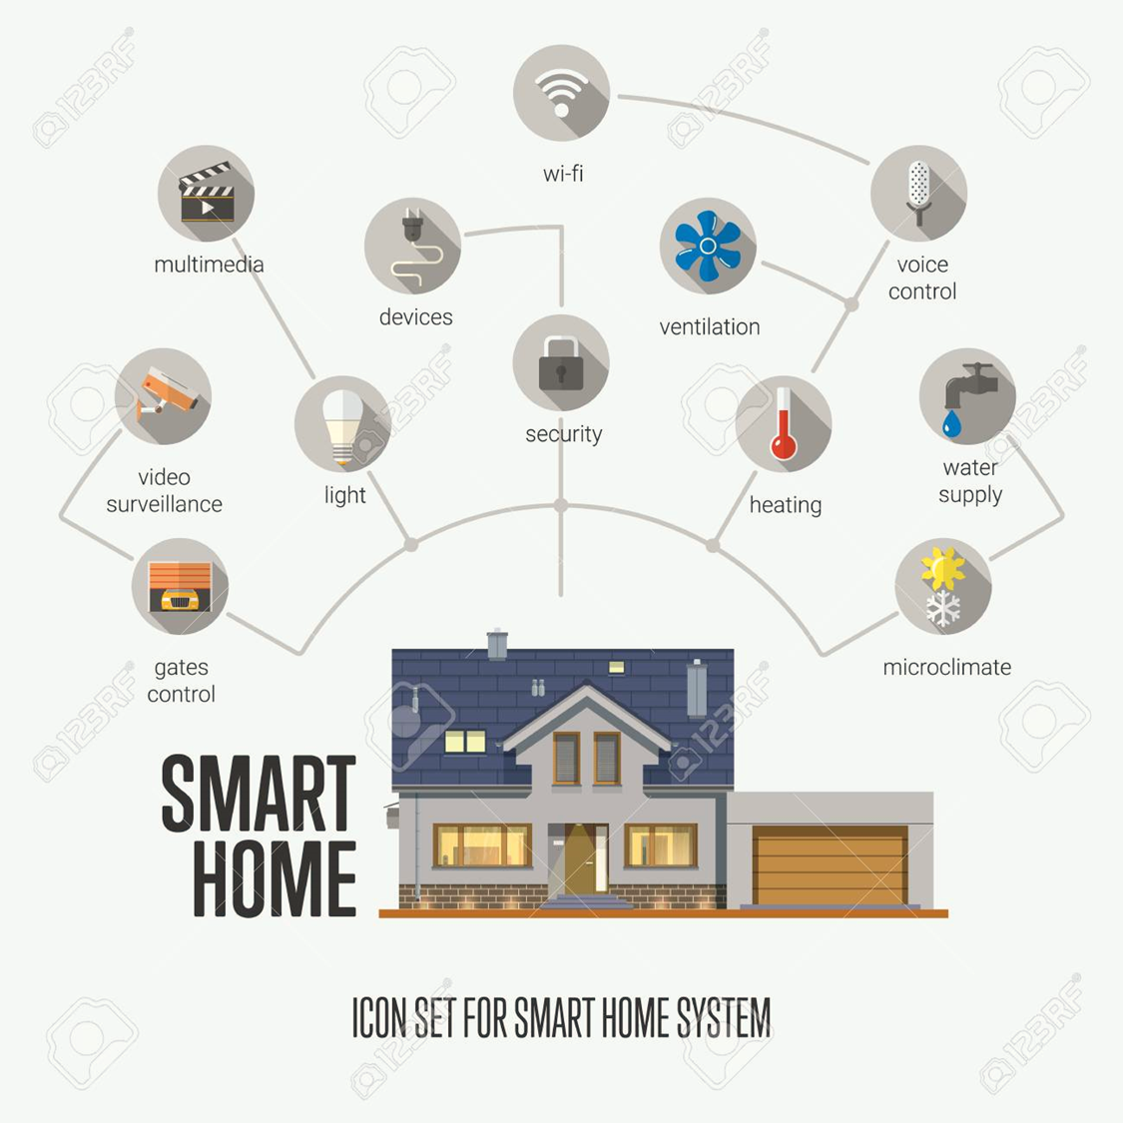

Basic
Cr: 123RF.com

Slide 3

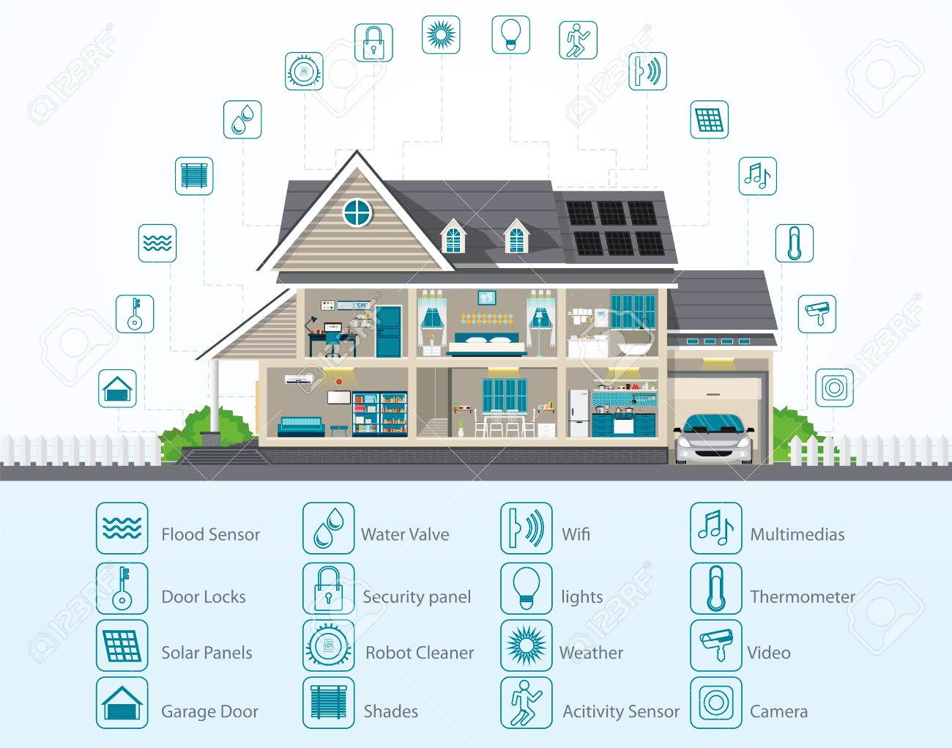
Advanced
Cr: 123RF.com

Slide 4
Requirements
Clean and tidy up things on its own
Remotely controllable and schedulable
Yield space for users when requested
Notes:
Feel free to add other requirements

